Slide 1
COMP2003
Group B
South Hams Society Website
Client Presentation
Thomas Philpott
Harry Parker
Oliver Donnellan
James Rudd

Slide 2
Product Vision
Our vision is to create an informative and accessible website for the South Hams Society that will make a difference and inspire.
Target Group
Requirements
Product
Goals
Members of the South Hams Society
Anyone who is interested in the South Hams Society from all ages.
Simple
Accessible
Engaging
Accessible from any device
Easy to navigate
Abundant in news and information about the South Hams Society
Increase membership for the South Hams Society
Create a resourceful and elegant website
Notes:
Target group: People who are concerned about planning in the South Hams

Slide 3
Our Main Objectives
Over the planning of the web application, we have set out some main objectives for developing the project.
Administration
Membership
Design
We have been working on the implementation of Drupal as requested by the client to allow the administrators of South Hams Society to manage content and maintain the website.
We are aware that members of the South Hams Society will have different permissions, so we will be implementing permissions to:
prevent non-admin users from accessing/editing certain content on the website
add two different admin permissions, one admin role will have the ability to control the whole website, and the other will only be able to post.
We are continuously enhancing our design based on the client's constructive feedback
Gaining membership is a crucial part of the South Hams Society website, so we have been working on developing a new membership form to replace the current pdf form.
This membership form is created to be:
Convenient
Easy to understand
Accessible
Improving the flow of the website so users have no problem with navigating
Testing that the design is accessible to all users is a big factor, such as ensuring text readability for users who are visually impaired
Ensuring that the website has cross-device functionality, so it functions properly on phone's as well as computers.
Notes:
Ensuring that the website is manageable by you is a crucial objective.
Convenient - The user isn't required the scan the form, they only need to enter the details.
Easy to understand - Each input box will have a clear visual label indicating what the user needs to enter.
Accessible - Clear and readable text, keyboard navigation, error messages.

Slide 4
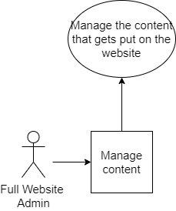
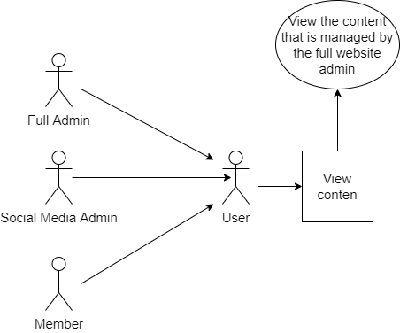
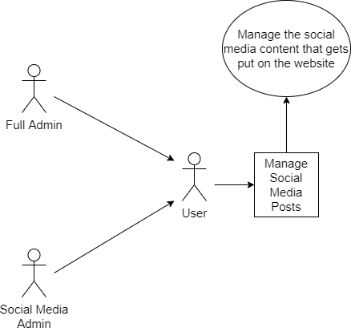
User Stories
These are the user tasks that we want website users to do
User Story 1
As these users, I would like to manage the social media content that can be viewed on the website
User Story 2
As these users, I would like to manage the content that can be viewed on the website
User Story 3
As these users, I would like to view the content on the website
Notes:
User Stories
Managing social media content on website
Managing website content
Viewing website content

Slide 5
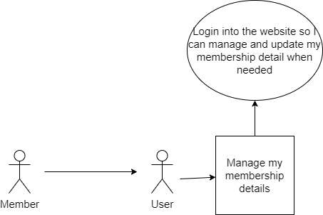
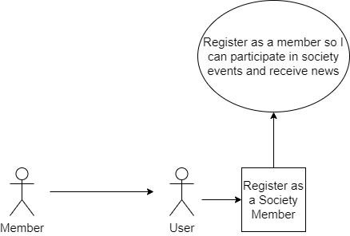
User Stories - more examples
These are the user tasks that we want website users to do
User Story 4
As these users, I would like to be able to register as a society member and show my interests to receive news
User Story 5
As these users, I would like to be able to login to manage and update my membership details when needed.
Notes:
User Stories
Managing social media content on website
Managing website content
Viewing website content

Slide 6
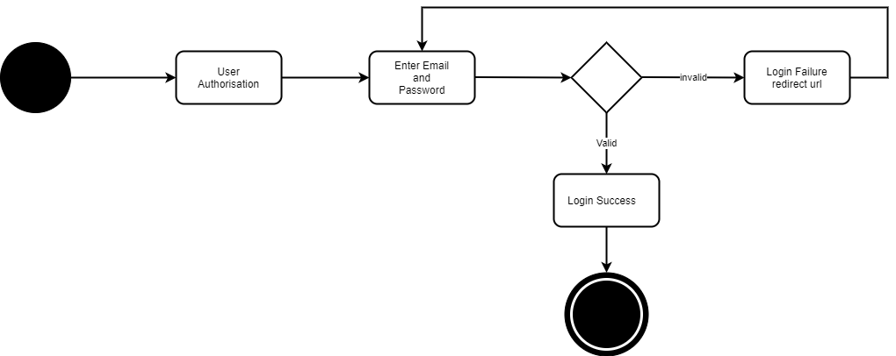
State Diagrams
Process of logging in
Notes:
Class DIagrams

Slide 7
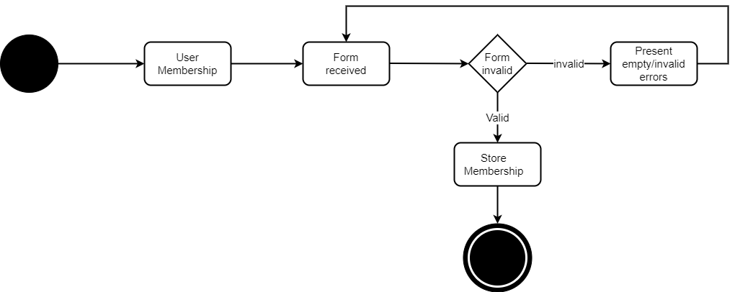
State Diagrams
Process of an user filling in a membership form
Notes:
Class DIagrams

Slide 8
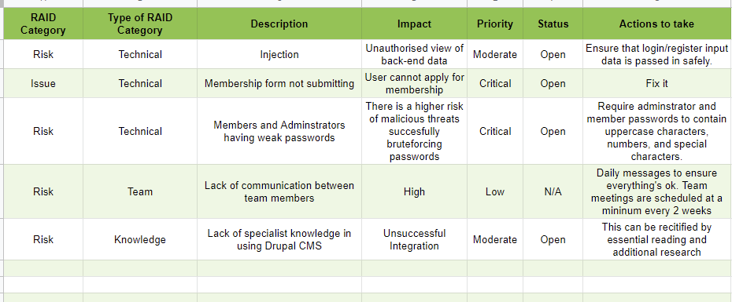
Risk Management Plan
Plan of us managing and solving risks
We separate the risks into 3 categories: Technical, Team, Knowledge.
Then we discuss the impact and should it be high priority.
List what actions could be performed to prevent/manage a risk.
Notes:
Class DIagrams

Slide 9
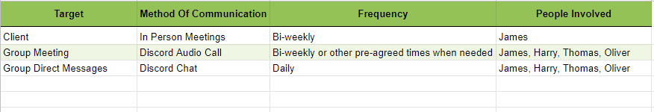
Communication Plan
Plan of us on how we communicate with each other and other parties
We try to maintain at least daily contact with each other so then there’s less chance of miscommunication or confusion.
Notes:
Class DIagrams

Slide 10
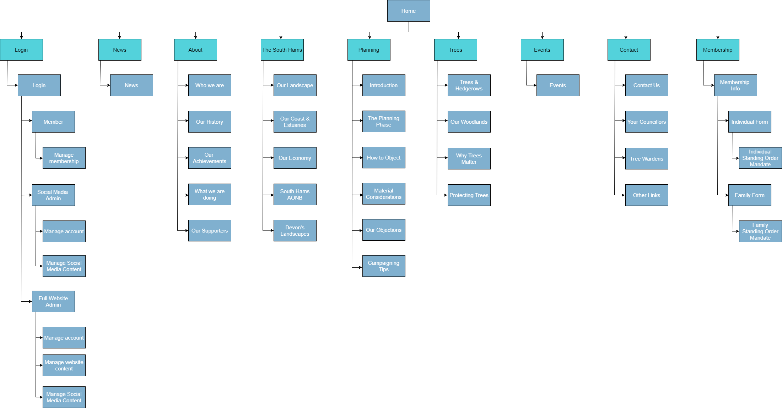
Sitemap
Shows the user how to get to each page
Notes:
Class DIagrams

Slide 11
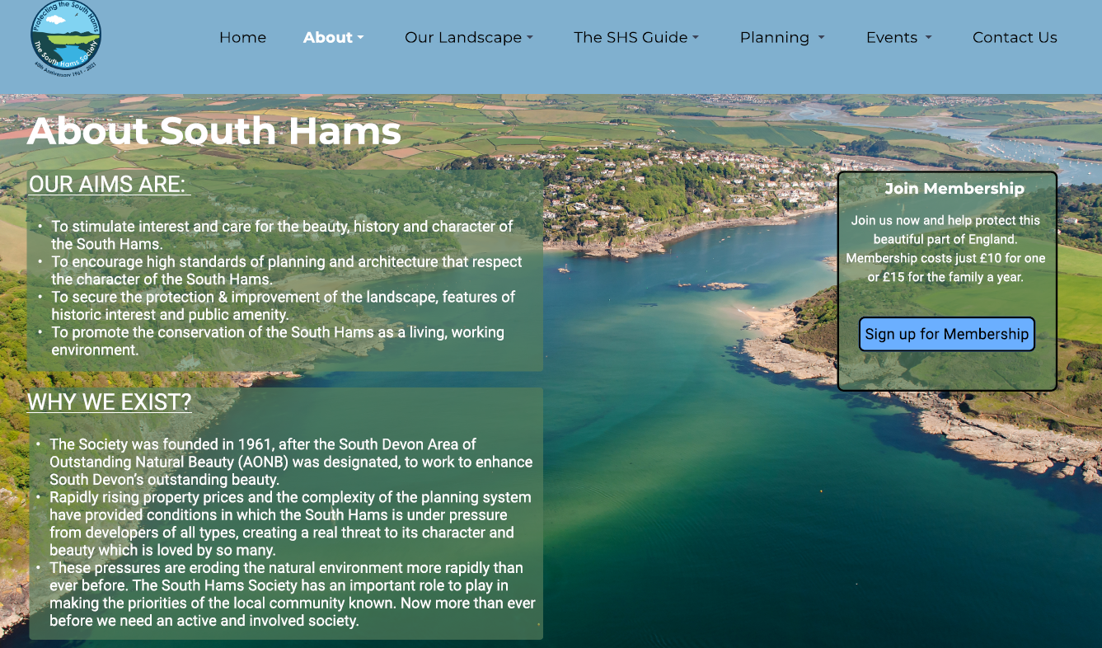
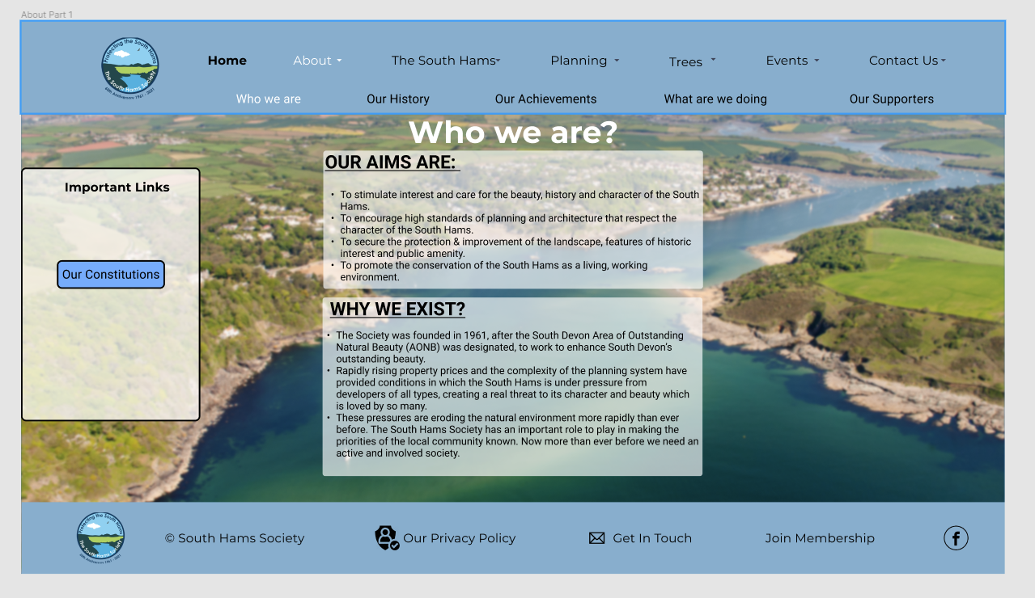
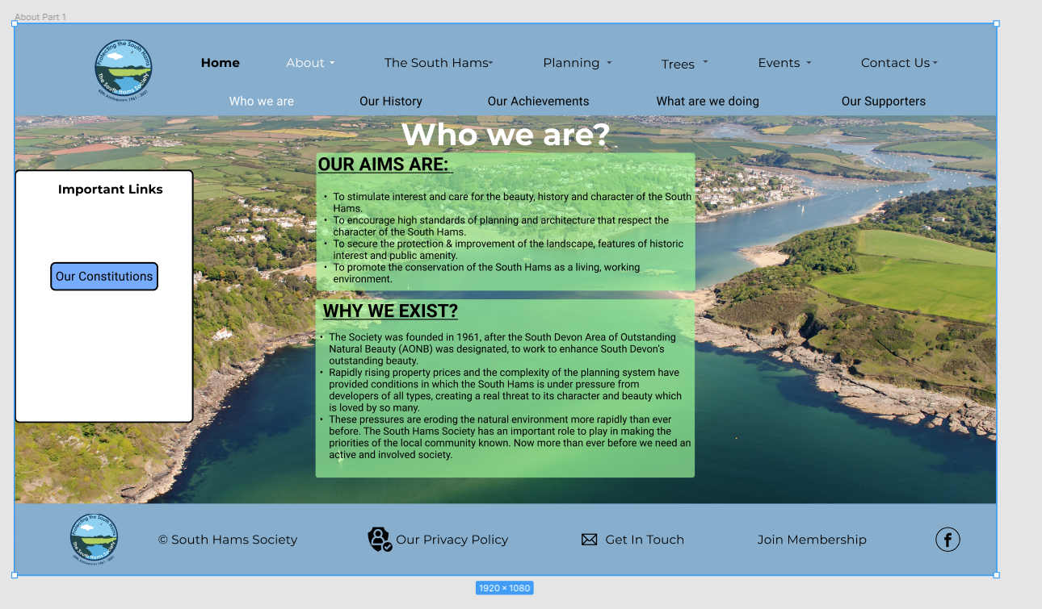
Designs - prototyped in Figma
Key differences from initial to newest design
Updated navbar to fit individual pages
Made the colour scheme more accessible for everyone
Easy to use interactive design
Version 1
Version 3
Version 2
Notes:
Class DIagrams

Slide 12
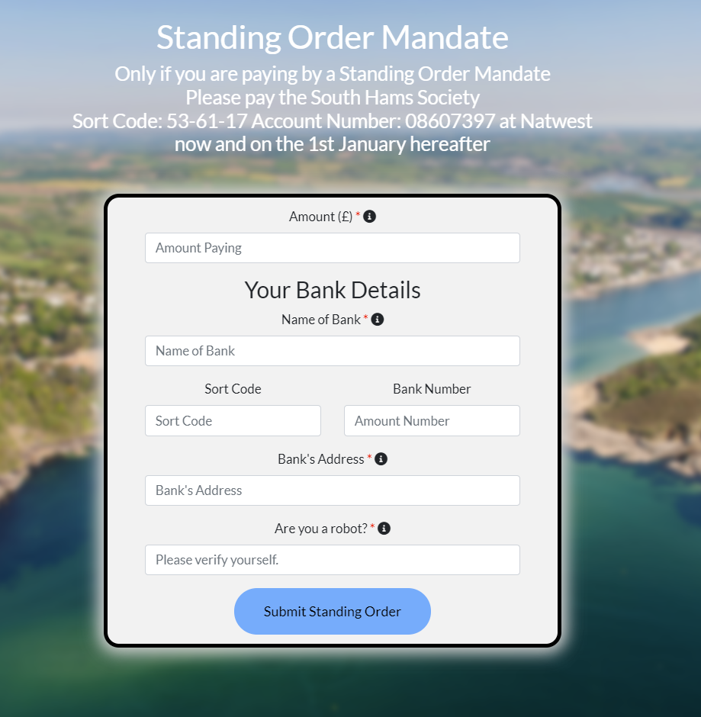
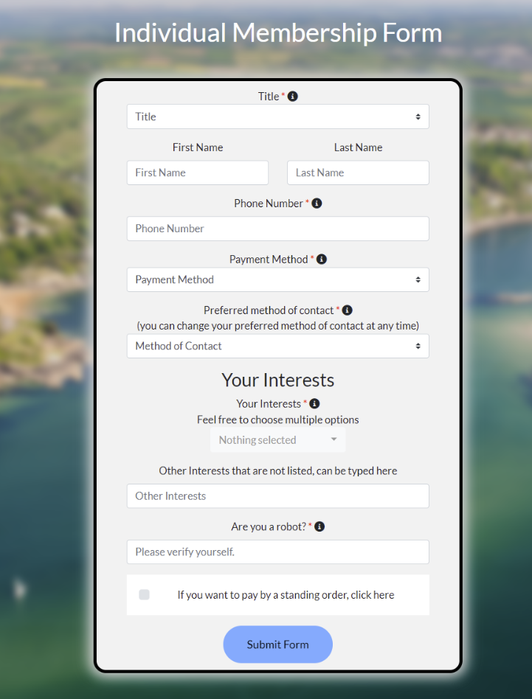
Initial prototype illustrating one key concept from the project.
Key concept:
Membership form!
As before the member had to print off the form in paper then post it.
Now it’s all online and can be stored on a user account where the details can be edited e.g. Method of contacts or interests
Notes:
Class DIagrams

Slide 13
For the future…
Implementing drupal
Storing membership details
Allowing admin accounts
Allowing users to edit membership details
Notes:
Class DIagrams

Slide 14
Demo!
Notes:
Class DIagrams

